Slide 1
Small network

Slide 2










Dataset
Traning: 55 rosette, 110 non-rosette.
Testing: 23 rosette, 46 non-rosette.

Slide 3
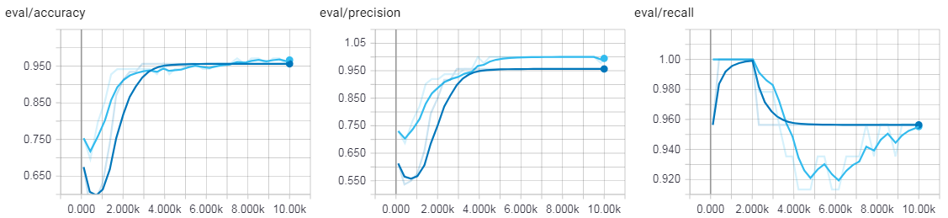
Network training

Slide 4
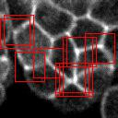
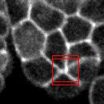
Example 1
Threshold at 0.75
Threshold at 0.9

Slide 5
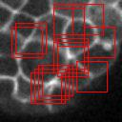
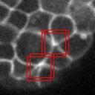
Example 2
Threshold at 0.75
Threshold at 0.9

Slide 6
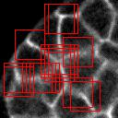
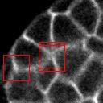
Example 3
Threshold at 0.75
Threshold at 0.9

Slide 7
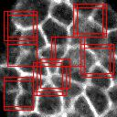
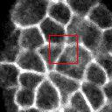
Example 4
Threshold at 0.75
Threshold at 0.9

Slide 8
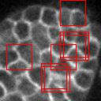
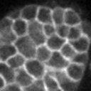
Example 5
Threshold at 0.75
Threshold at 0.9

Slide 9
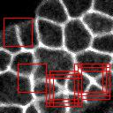
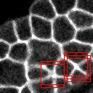
Example 6
Threshold at 0.75
Threshold at 0.9

